Slide 1

Note: The data and information in this document is reflective of a hypothetical situation and client. This document is to be used for KPMG Virtual Internship purposes only.
Sprocket Central Pty Ltd
Data analytics approach
[Division Name] - [Engagement Manager], [Senior Consultant], [Junior Consultant]

Slide 2
Note: The data and information in this document is reflective of a hypothetical situation and client. This document is to be used for KPMG Virtual Internship purposes only.
Agenda
Introduction
Data Exploration
Model Development
Interpretation

Slide 3
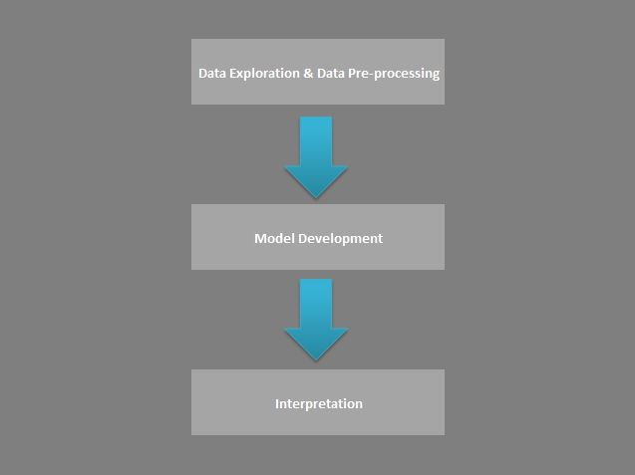
Note: The data and information in this document is reflective of a hypothetical situation and client. This document is to be used for KPMG Virtual Internship purposes only.
Introduction
We’ll follow this data analysis pipeline, so that the process flow would be smooth and organized
We would follow these data analysis pipelines –
Data exploration
Model Development
Interpretation/Insights from the model
Among the 3 pipeline component Data-pre-processing will be of major focus, as the later components will require good data for final predictions

Slide 4
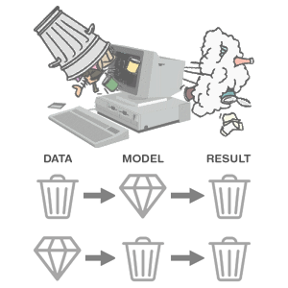
Note: The data and information in this document is reflective of a hypothetical situation and client. This document is to be used for KPMG Virtual Internship purposes only.
Data Exploration
Why Exploration and Pre-processing?
Issues we’ll take care –
Missing Data (deletion & imputations)
Understand the data distributions
Duplicate data(remove)
Correcting labels to be uniform ensuring consistency( e.g. ‘NSW ‘ or ‘New South Wales’ to be used, ‘M’ or ‘Male’ should be used)
Dropping irrelevant features for analysis
Removing multi-colilnearity (e.g. age & tenure)
Looking for correlations
Encoding the categorical variables as required by the algorithms
Removing outliers if needed
Converting DOBs into age so that we can look for patterns in age segments
Transforming test data using Standard Scaler,Encoding after fitting to the training data
Why essential – Garbage-in-Garbage-out
P.C. : https://thedailyomnivore.net/2015/12/02/garbage-in-garbage-out/

Slide 5
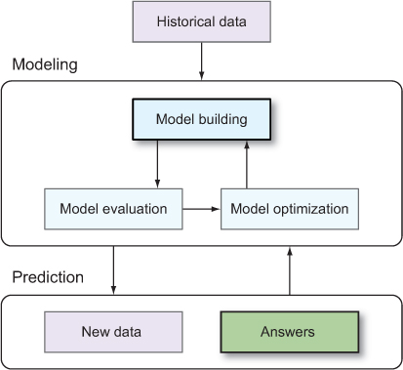
Note: The data and information in this document is reflective of a hypothetical situation and client. This document is to be used for KPMG Virtual Internship purposes only.
Model Development
Looking for pattern in the data
Input – Pre-processed data
Output – Predictions
Test the model with validation data derived from a part of training data
Why error - model is not well fitted to training data, not able to capture the pattern
Beware of Overfitting & Underfitting problems
Model should generalize
Choosing the right metric for evaluation
Tune hyperparameters
Finally evaluating on the new NewCustomerList
P.C. : https://livebook.manning.com/book/real-world-machine-learning/chapter-3/11

Slide 6

Note: The data and information in this document is reflective of a hypothetical situation and client. This document is to be used for KPMG Virtual Internship purposes only.
Interpretation
Who are those potential customers?
Find out potential customers from the built model
Interpretations of Visualizations
Interpretation of results obtained
P.C.: https://www.indiamart.com/d-vois-ssv-broadband/

Slide 7
Note: The data and information in this document is reflective of a hypothetical situation and client. This document is to be used for KPMG Virtual Internship purposes only.
Appendix

Slide 8
Note: The data and information in this document is reflective of a hypothetical situation and client. This document is to be used for KPMG Virtual Internship purposes only.
Appendix
We may also need additional information in order to gain more insights
We’re going to refer ABS (https://www.abs.gov.au/statistics) if needed to create more relevant features
such as finding out the distances of individual’s home to office, as the distance might be an important factor
behind Buying bikes

